Slide 1


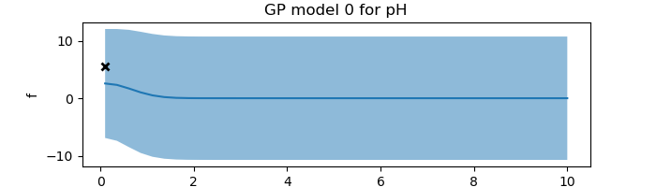
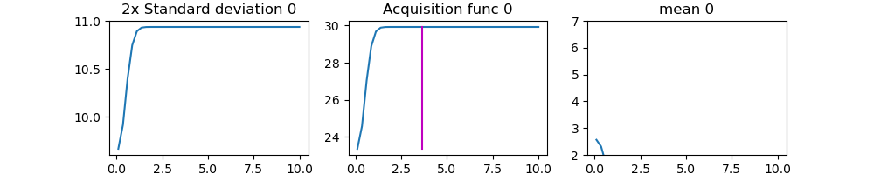
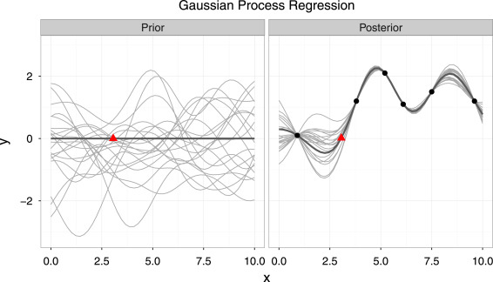
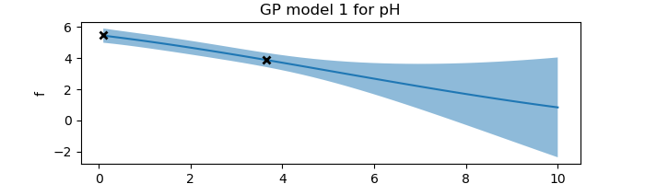
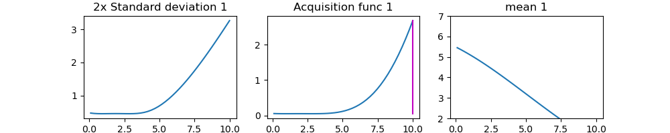
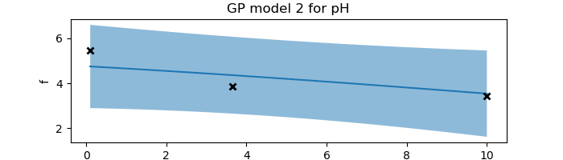
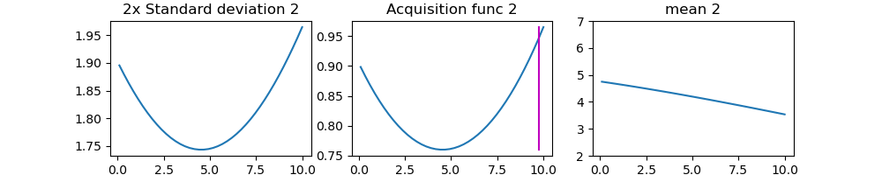
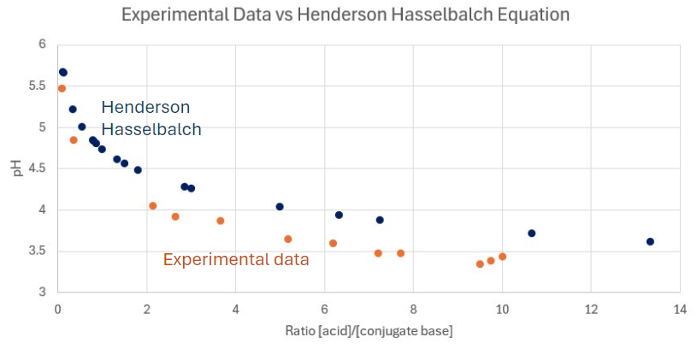
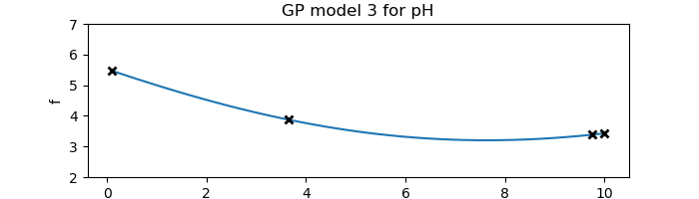
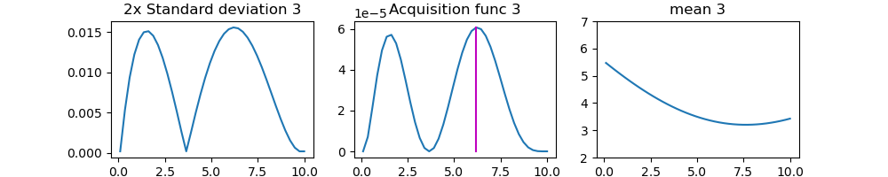
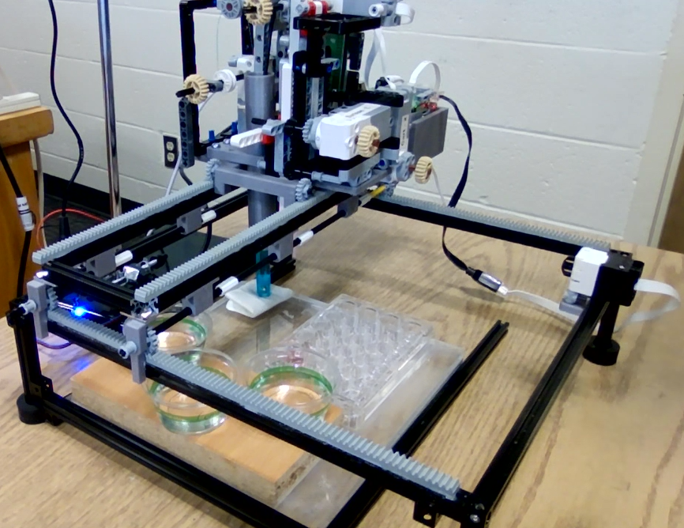
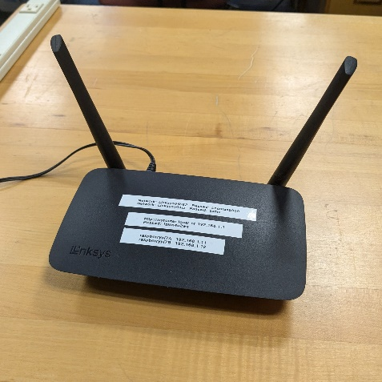
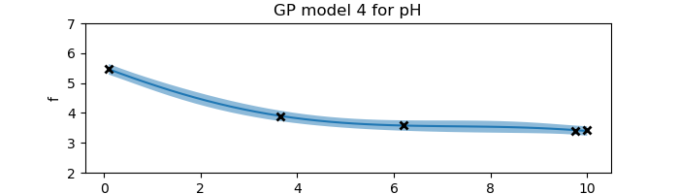
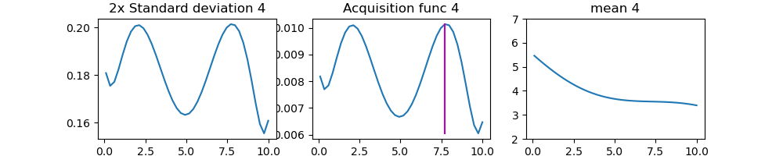
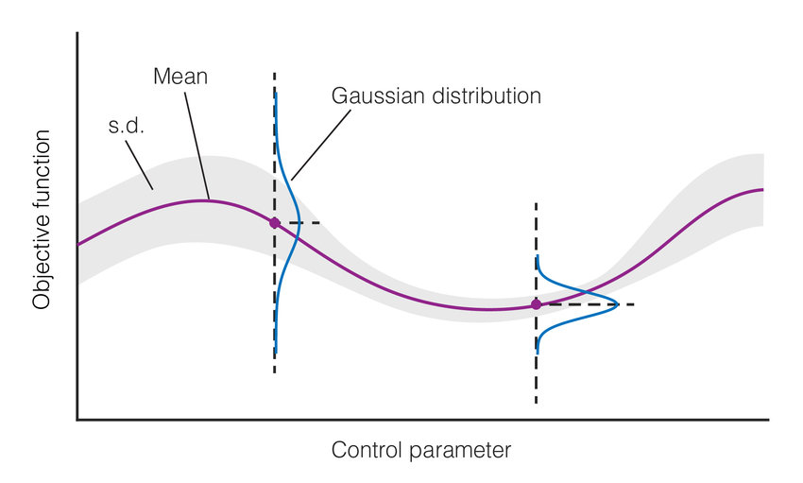
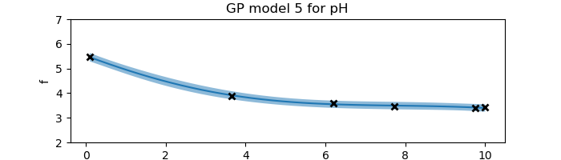
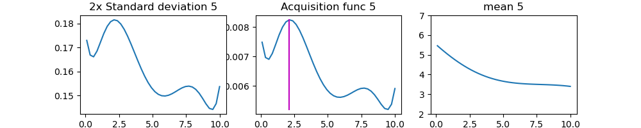
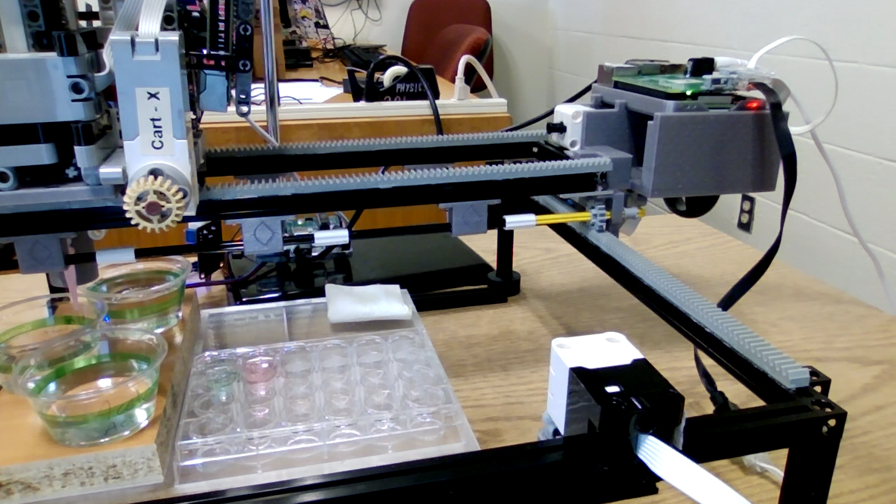
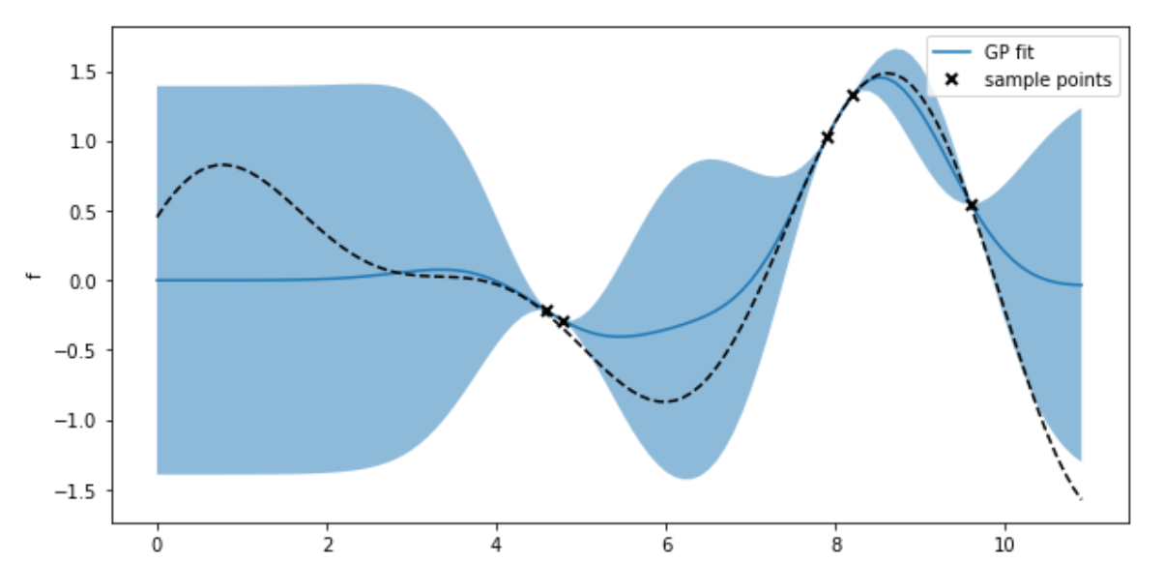
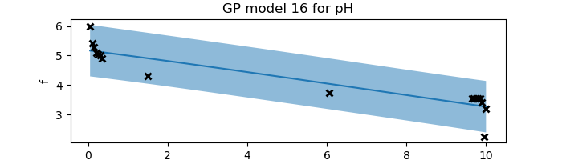
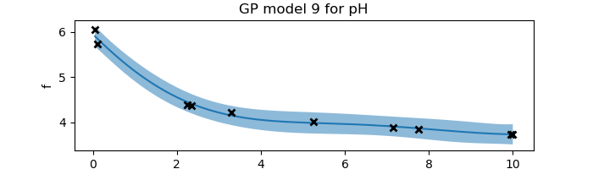
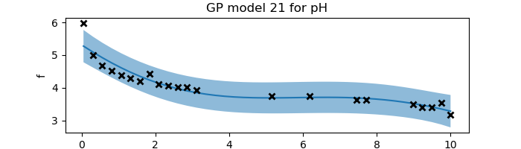
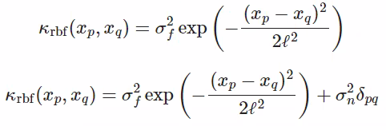
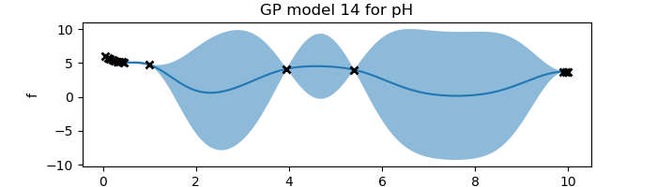
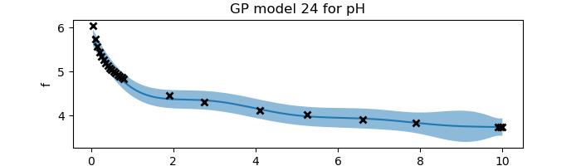
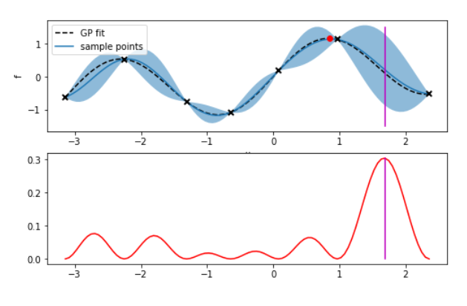
Automation and Machine Learning: How a Robot Can Conduct Its Own Experiments Using Gaussian Processes
Miller Gruen and Adi Timin
Advisor: Dr Mary Lowe, Physics Department, Loyola University Maryland
Introduction
Experimental Results: “Exploration”
When scientists need to take large amounts of data, rather than taking countless measurements that take time, resources, and money, it may be better to automate the task. Beyond that, what if a device were able to do more than simply repeat a task, what if it could make its own decisions and conduct an experiment wholly without needing constant human supervision? We can accomplish this using Gaussian processes applied to machine learning. LEGOLAS is a device capable of applying these principals to measure the pH of an acid and a conjugate base when mixed. This experiment may be more akin to a proof of concept, however this principal is extremely valuable and can be applied to countless other disciplines.
Goal to understand machine learning
Look at exploration, combine with exploitation
Explored experimentally and computationally
Our goal is to discover the shape of the curve of the pH that results when mixing together an acid and a conjugate base.
We used Acetic Acid and Sodium Acetate.
We begin by taking a measurement at 0.1 ratio of the [acid]/[conjugate base].
From that, we obtain a measurement. With it, we obtain a curve with the uncertainty required to create an acquisition function.
From this, we obtain the next data point.
This continues until the curve is found.
argmax = … this is for the acquisition function
Theory and Background
Apparatus
Gaussian processes is a method of doing regression. It tells us which functions are most likely to describe the data we are observing at any time during an experiment. When we have no data, our prior model has endless possibilities. Then as we observe more and more data, we get a better idea of the true underlying function. This regression method is non-parametric, which means we don’t have an equation that describes the function we are fitting, just a curve - a set of points.
Legolas possesses:
2 Raspberry Pis and build hats to control motors
5 Lego Motors
1 Arduino and 1 pH sensor
1 pipette with a plunger
The Raspberry Pis connect wirelessly to a computer running the code and run the Lego motors using a build hat to connect.
Figure 1
In essence, a Gaussian process is a collection of normally distributed random variables. Thus, for each value of the control parameter, we have a Gaussian probability distribution (a.k.a. a Bell curve) as an output. The variance in the distributions tells us about the uncertainty in the function. Where we have a better idea of the underlying function, the distributions are narrower. This plotted variance includes both the uncertainty in the model due to the lack of data we have (epistemic uncertainty), and the noise and fluctuations in the data itself (aleatoric uncertainty). The uncertainty is plotted on Figure 3 as the light-blue region (2 standard deviations). The darker-blue line on this graph is the mean of the function, what we call the surrogate function. It is the curve that most likely represents the true curve. The underlying curve that we desire to find the shape of is plotted with the black dotted line.
The way to find out the shape of our surrogate function is by using a ”kernel” (covariance function). For any two given inputs, it tells us
Lego motor
Computational & Experimental Results: New acquisition function
Figure 2
Water
(rinsing)
Raspberry Pi and Build Hat
Base
Limit switch
Acid
Figure 3
Standards
Experimental wells
Written in python
Jupyter
Gp calculations done on computer
The code is able to:
Establish communication between computer and pis
Functions for:
moving the motors in the x and y directions
Pipetting liquid
Moving pH sensor vertically
pH measurement
Cleaning and drying the pH sensor
GPy code
Function to establish RBF kernel
Function that does the regression
Function that uses active learning methods to determine the next data point to measure
Figure 4
Argmax = 5*sqrt(n)*variance + slope
how similar the outputs are, and thus informs us of the shape the surrogate function is likely to take (if the outputs are more similar, the function will be smoother, an vice versa). The kernel is also used to construct a covariance matrix, which we use to calculate the mean and the variance of the function
at each point (which is how we get such a visualization as on Figure 3).
This information is then used to determine what the best data point to take next is. For that we use an “acquisition function”, which quantifies the desirability of taking a measurement at each point. If the acquisition function is equal to the variance, we will take the measurement where the uncertainty is highest.
Acknowledgements
References
We wish to acknowledge Dr Lowe, the Loyola Physics Department, the Hauber Research Fellowship Program, George Hall, Gilad Kusne, and the UMD and NIST team working on Legolas.
Add your information, graphs and images to this section.
Figure 5

